Slide 1
SSH Hub for Model 2.5 Implementation
Southern California Kaiser Permanente/
UCLA Center for Vaccine Research
June 2004

Slide 2
Introduction / Background
Model 2.5 allows automatic access to data residing in remote sites.
A central server holds the SAS jobs to be processed on the remote sites. Each site has a system to periodically check the server for SAS jobs. If present, the system downloads, process them, and uploads the results to the server.
Model 2.5 relied on File Transfer Protocol (FTP) for data transfers. Security concerns prevented its full implementation as FTP transmits in clear text, i.e., passwords and files are visible across the internet.
To increase security, SCK proposed Secure Shell (SSH) to replace FTP. SCK setup and successfully tested a SSH server with CDC. At the request of CDC VSD, SCK offered to host the SSH hub in Torrance CA. We completed the SSH hub setup early March. Its been operational since then.

Slide 3
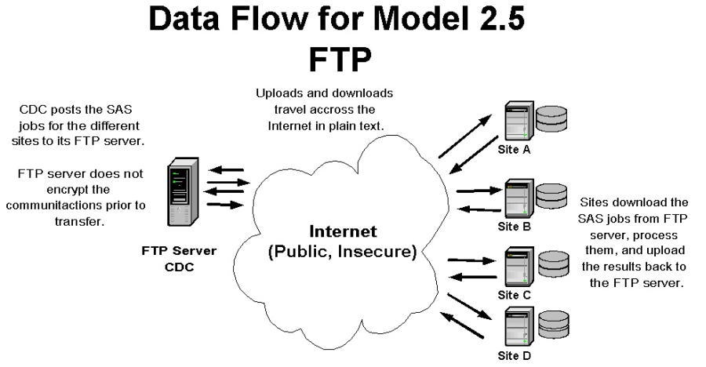

Slide 4
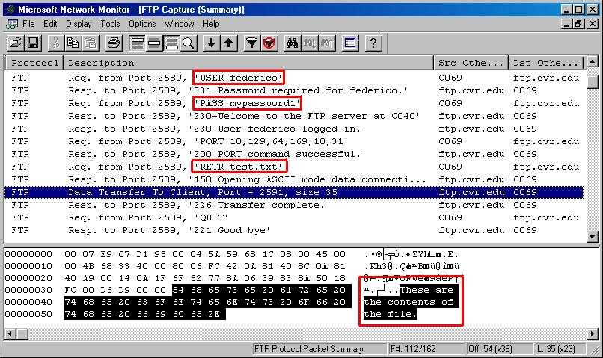
FTP transmits in clear text.

Slide 5
Typical Internet transmission
Each packet has to go through a number of public routers as it travels across the internet. The example given below is a typical transmission.
Each numbered line represents a place where the pocket can be examined. Hackers can potentially read the contents of the pocket at anyone of these points.
traceroute to 162.119.232.103 (162.119.232.103), 64 hops max, 40 byte packets
1 noc253.rei.edu (192.168.6.253) 1.342 ms 0.838 ms 0.614 ms
2 63.193.68.5 (63.193.68.5) 11.659 ms 17.386 ms *
3 216.102.180.105 (216.102.180.105) 15.494 ms 87.893 ms 223.900 ms
4 bb1-g1-3-0.lsan03.pbi.net (206.13.29.144) 128.984 ms 14.655 ms *
5 ex1-p9-0.eqlaca.sbcglobal.net (151.164.191.237) 110.942 ms 18.379 ms *
6 sl-st20-la-4-0.sprintlink.net (144.232.154.229) 105.665 ms 85.317 ms 131.623 ms
7 sl-bb21-ana-13-0.sprintlink.net (144.232.20.66) 5.602 ms 5.737 ms 5.321 ms
8 * sl-bb22-ana-15-0.sprintlink.net (144.232.1.174) 5.780 ms 11.127 ms
9 144.232.9.238 (144.232.9.238) 9.115 ms 52.126 ms 40.805 ms
10 bur-core-01.inet.qwest.net (205.171.13.9) 17.187 ms 13.458 ms *
11 bur-edge-01.inet.qwest.net (205.171.13.14) 262.884 ms 166.536 ms 135.449 ms
12 65.114.176.50 (65.114.176.50) 124.778 ms 85.934 ms 42.988 ms
13 * * *

Slide 6
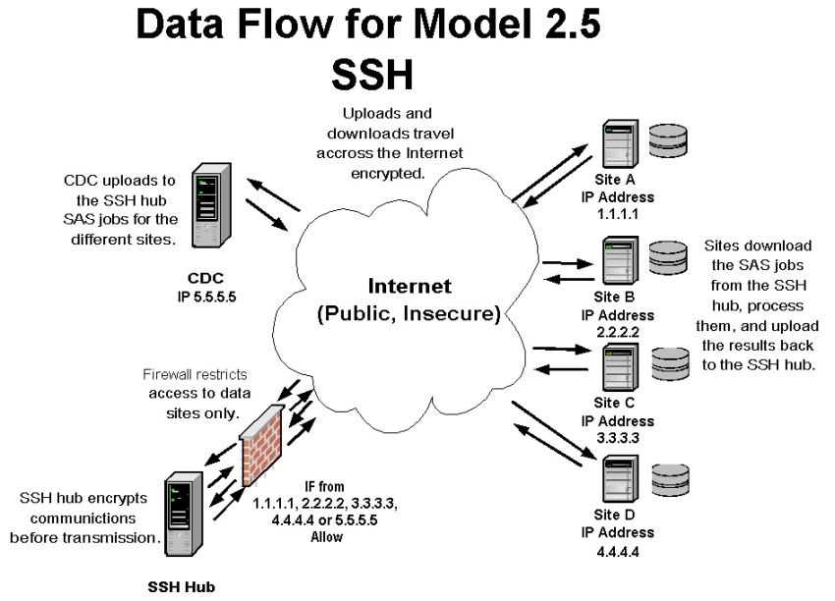

Slide 7
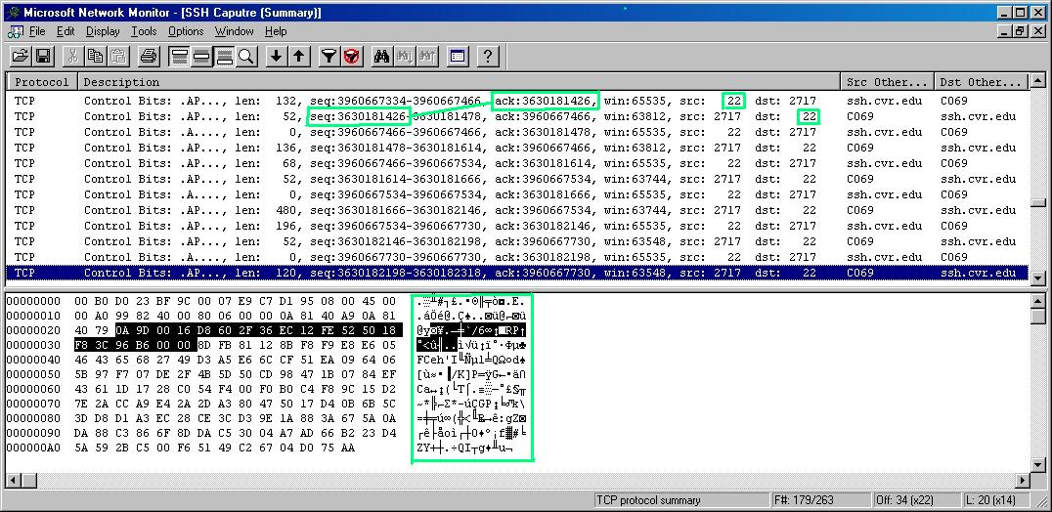
SSH transmits in encrypted text.

Slide 8
SSH Hub Implementation at SCK
Operating System
Server Software
Current Features
Maintenance Requirements
Usage Statistics

Slide 9
Operating system: FreeBSD (Berkeley Software Distribution)
Stable, Robust, Mature
  Derived from the first popular version of UNIX developed at the University of California at Berkeley.
  Large team of developers and users willing to lend free support.
Free Licensing
  Freely distributable under the BSD license by the Regents of the University of California.

Slide 10
Server Software: OpenSSH
Stable, Robust, Mature
  Derived from the original free SSH 1.2.12 release.
  Most popular version of SSH.
  It runs long periods of time without user intervention.
  It was originally on a BSD system.
  Installed by default with FreeBSD.
Feature Rich
  Implements the latest standard for the SSH protocol, version 2.
  Strong encryption.
  Data compression before encryption improves the performance for slow network links.
  Strong authentication protects against several security problems, e.g., IP spoofing, fake routes, and DNS spoofing.
Free Licensing
  OpenSSH is distributed under the same free BSD license as FreeBSD

Slide 11
SSH Hub Current Features
Restricted access
  Only sites with specific internet addresses may access through the Vaccine Center’s firewall.
Independent home directories
  Each site has a different home directory, separate from everyone else’s.
  Sites cannot access other sites’ home directories.
Easy to replicate
  The system replicates with a single command.
  Can replicate across the Internet.
  The replication occurs securely using the SSH v2 protocol.
Mirror servers configuration
  Two servers with same user accounts and SSH server public key.
  File systems replicated constantly.
  Easy recovery in case of hardware failure in main server.
  Allows for staged patch process.

Slide 12
Maintenance requirements
Need to update the Vaccine Center’s firewall every time a site changes the ip for its distributed model server.
Need to patch FreeBSD or OpenSSH every time a new security vulnerability is discovered in the operating system or server software.
Need to subscribe to security news letters and bulletins from the United States Computer Emergency Readiness Team (US-CERT) and FreeBSD.

Slide 13
Usage Statistics
Working problem-free and without downtime since it first came on-line March 8, 2004
Every Model 2.5 provided its public IP to gain access to the SSH server and currently uses the SSH server
In ideal network conditions, a login connection is established in 0.37 seconds.
Server accepts over 2000 login requests per day. About 1500 are CDC connections. About 500 are connections from all other sites.

Slide 14
Conclusion
The SSH hub is in place and functioning well.
Sites are now able to securely transfer data.

